Slide 1
Computer vision

Slide 2
Image classification
Object detection
Segmentation
Face recognition -> emotion recognition
Pose estimation
Image captioning -> image description
Image restoration -> super zoom
People Detection
Scene reconstruction

Slide 3
Brief story of nerve stimulation
Every cell has several dendrites, each potentially influenced by different chemical substances (neurotransmitters).
Some neurotransmitters initiate an action potential, while others inhibit its formation.
If the neurotransmitter concentration is very low, or similarly it includes inhibitory materials, it may not activate the dendrite.
Ultimately, the soma receives the summation of activation potentials from all dendrites. Depending on this value, the neuron decides whether to transmit the message or inhibit it .
If this summation exceeds a threshold, it triggers the opening of voltage gates at the axon hillock, leading to the propagation of the action potential along the axon and the subsequent release of neurotransmitters. However, if the summation is not strong enough, it fails to propagate the axon and the process is halted, causing the neuron to turn off.

Slide 4
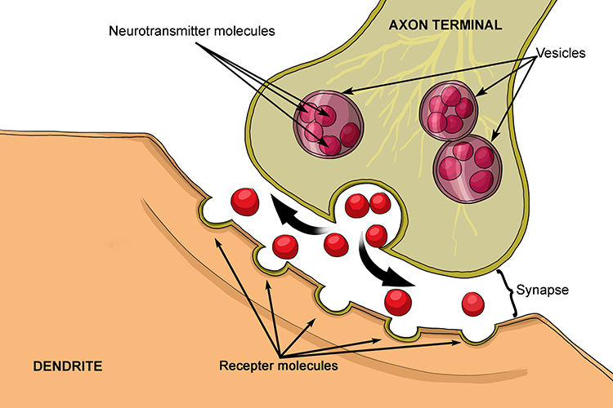
Lets express it in Math
Evoking action potential related to:
Amount
Substance type
Suppose that for substance X, it can evoke an activation potential(A) that is linearly related to its concentration.
A = w * X + b

Slide 5
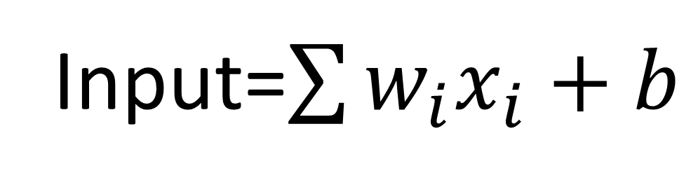
The whole amount of activation potential that soma received is the summation of each dendrit produced.
Input=$\sum{w_{i}x_{i}}+b$

Slide 6
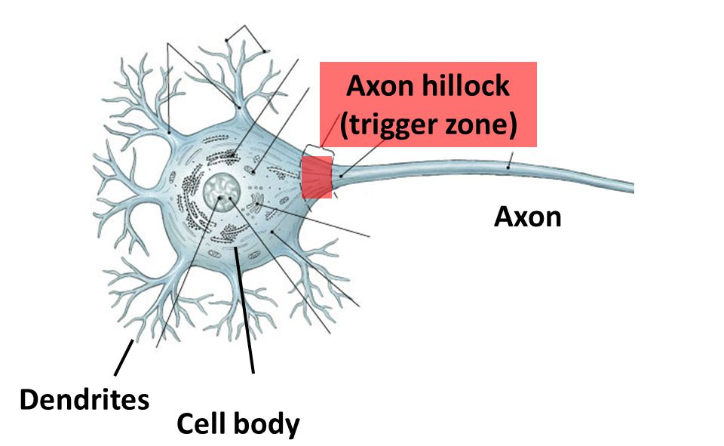
Suppose that if the summation of activation potentials is grater than -30 v, the signal will be transmitted unless it is inhibited
F(input) = 1 if input>-30
= 0 if input <-30
Out = f(input)

Slide 7
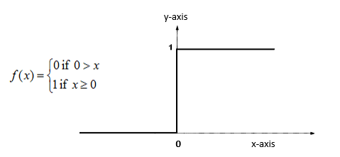
Activation functions
Decide to produce an output:
Zero for zero and negative input, one for every positive values -> step function

Slide 8
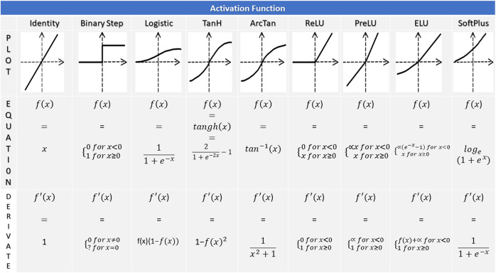

Slide 9
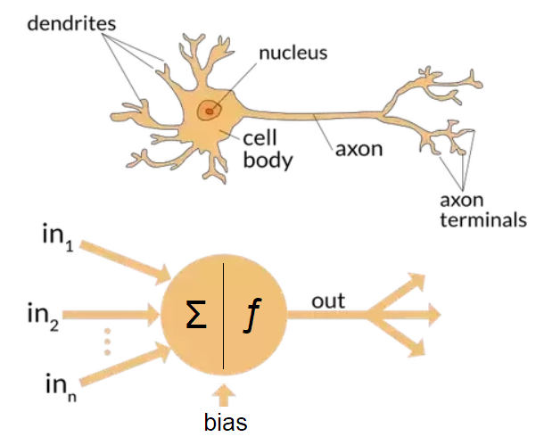
w1
w2
wn

Slide 10
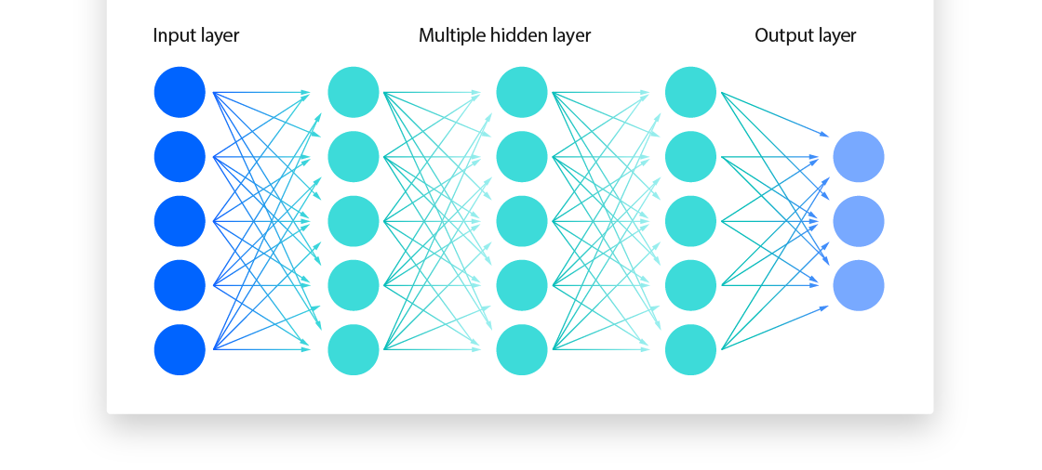
One neuron is not a pro…
Fully connected Network

Slide 11
Biologic learning
Repetition is the mother of learning.… why?
You perform a task, refine yourself based on your achievements, and repeat the process multiple times until you are satisfied. After reaching satisfaction, you approach your tasks with heartfelt dedication.
What was happened in our brain?
Neurons of a pathway is coupled tighter so signal transition become faster.

Slide 12
From a mathematical perspective, the weights attain their optimal values, enhancing the pathway's ability to execute a specific task effectively.
This phenomenon occurs across the entire network, where all weights converge to values that yield the optimal results for the network's task.

Slide 13
Lets highlight keywords
You perform a task without any prior knowledge, based on your achievements and its perfectness you will refine yourself , and repeat the process multiple times until you are satisfied. After reaching satisfaction, you approach your tasks with heartfelt dedication.
Random initialization
result
Cost function
Back propagation
epoch
Memorization

Slide 14
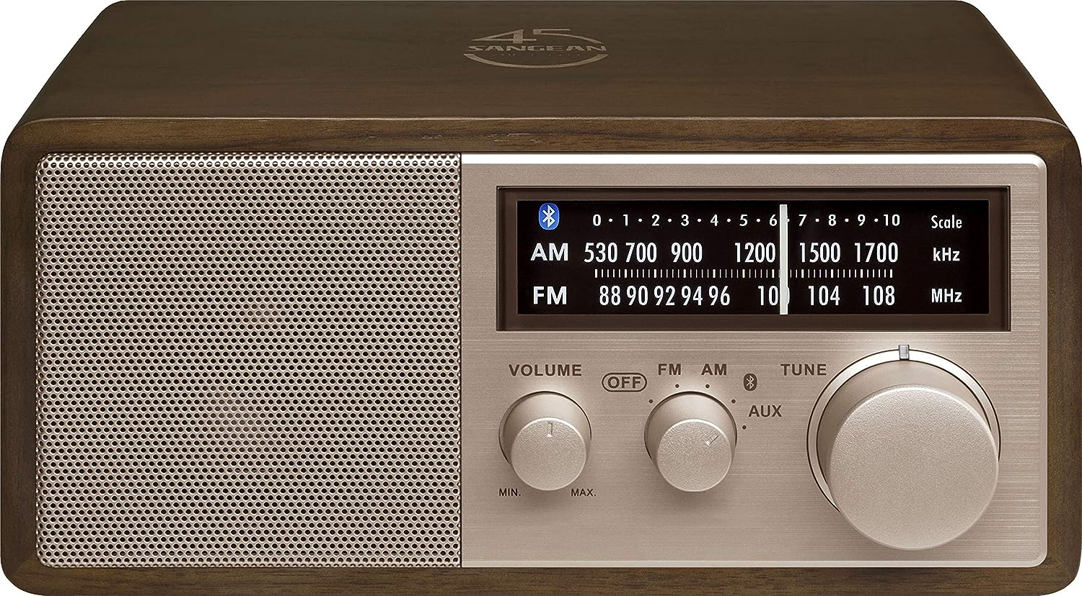
Learning
Changing weights up to gain the best result!

Slide 15
Best result?
The best result is the outcome we aim to achieve.
We should tell about the best outcome to the network… it means NN are trained under supervision.
We should give the target to the network, and measure how it is far from the favorable result.
There are many ways to assess the distance between produced result and favorable one:
MSE
Cross entropy
…
This is called the Cost Function

Slide 16

Example
Cycle 1
Cycle 2
Cycle n
Network result | My expectation
0 | 1
3 | 1.5
-0.4 | 1.6
0.9 | 0
0.6 | 0.6
Network result | My expectation
0.5 | 1
2 | 1.5
1.6 | 1.6
-0.1 | 0
0.9 | 0.6
Network result | My expectation
0.8 | 1
1.8 | 1.5
1.6 | 1.6
0.3 | 0
0.75 | 0.6
…
Cost function:
$$MSE=\frac{1}{n}{\left(\hat{y}−y\right)}^{2}$$
1.612
0.12
0.0485

Slide 17
When the network reaches a point where the cost is not changing, we consider it trained.
Initially, we have no knowledge of weights, so the initial weights is allocated by the chance, but we can measure the cost in each calculation cycle.
The best weights correspond to the lowest cost. Therefore, we are seeking weights that minimize the cost, a concept known as optimization in applied math. This problem must be solved using differential math.

Slide 18
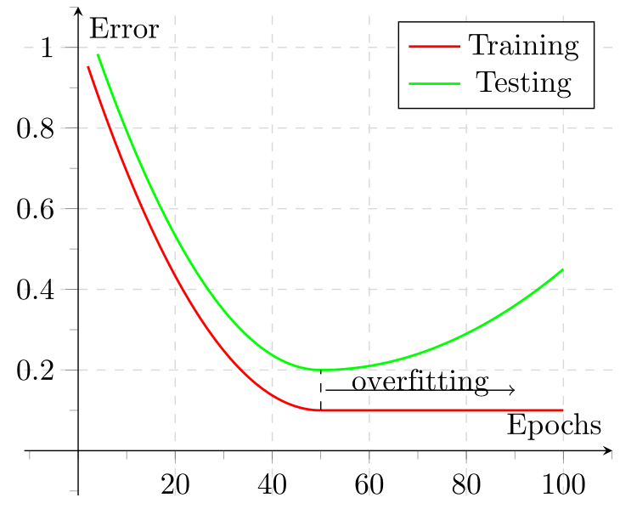

Slide 19
How to tune the weights?
Tuning is done by a process that is called back propagation, because it starts from the output end of network toward the input end.
There are several algorithms.-> Gradient Descend
Optimizers-> Adam,
Descending rate

Slide 20
Training cycle
Feed data, give the results, assess the cost.
Do the same up to attain the minimum cost

Slide 21
Memorizing and overfitting

Slide 22
Deep dive into math..

Slide 23
Lets review
Weights?
Activation function?
Learning?
Cost function?
backpropagation

Slide 24
Image

Slide 25
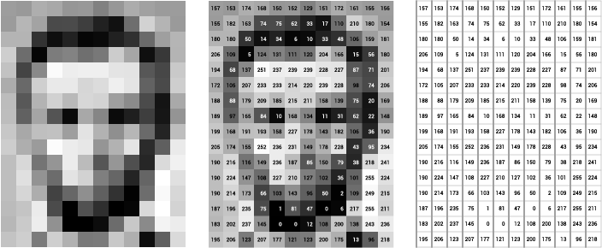
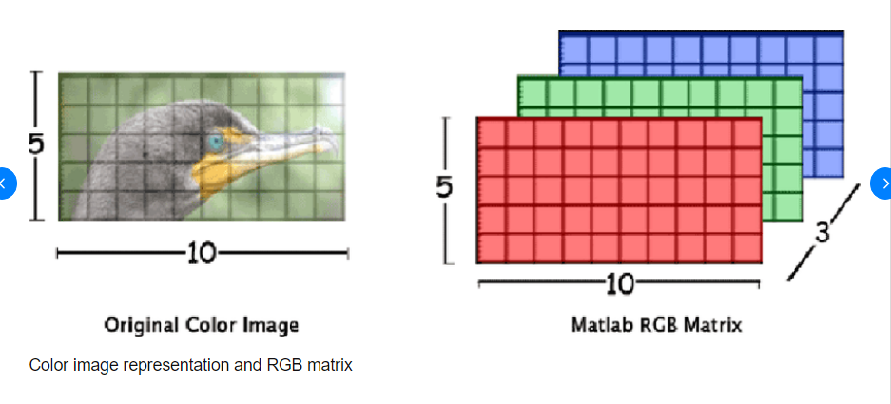
Images are matrices

Slide 26
How does computers comprehend a picture?
Aim is to find a representative vector for any image:

Slide 28
Images are 2D!
Convert any image to layers based on features (instead of colors)!!
Assigning meaning to the pictures by enhancing their convolutional state.
Kernel / filter
Feature map

Slide 29
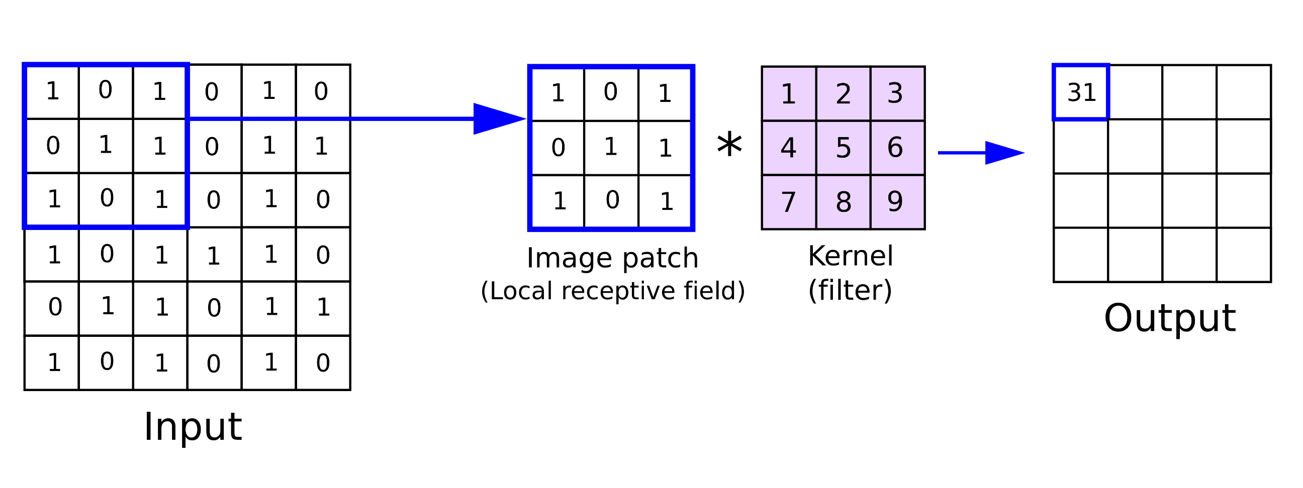
filter
Trainable matrix
Feature Map

Slide 31
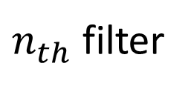
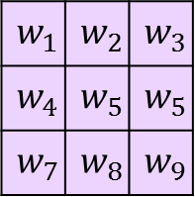
1 | 0 | -1
1 | 0 | -1
1 | 0 | -1
-1
2nd filter
…
Feature Map
$$w_{1}$$ | $$w_{2}$$ | $$w_{3}$$
$$w_{4}$$ | $$w_{5}$$ | $$w_{5}$$
$$w_{7}$$ | $$w_{8}$$ | $$w_{9}$$
$n_{th}$ filter

Slide 32
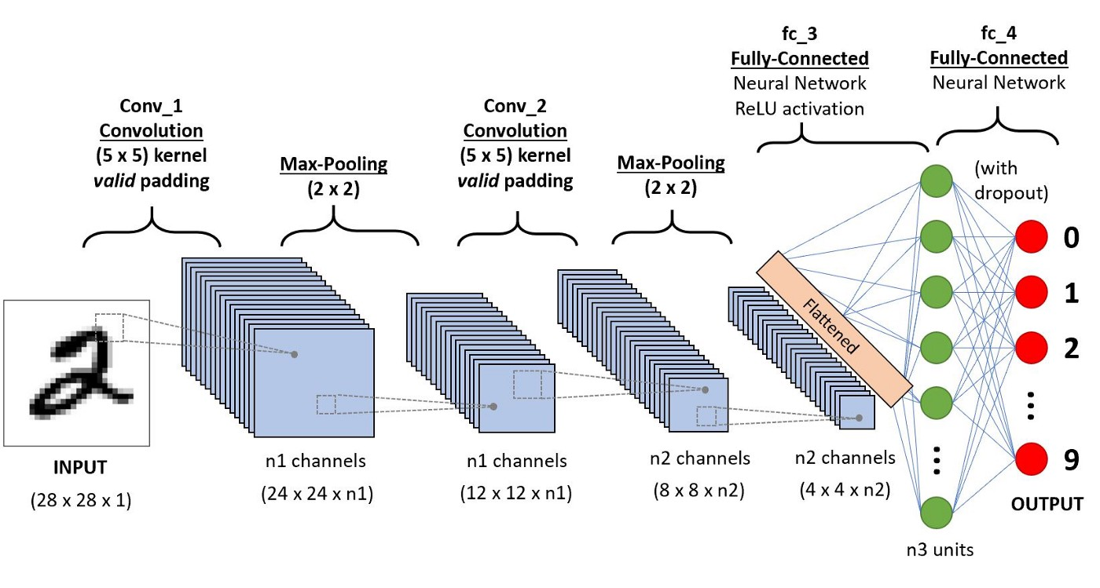
Stack of feature maps

Slide 33
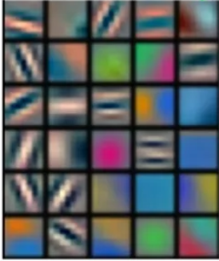

Slide 34
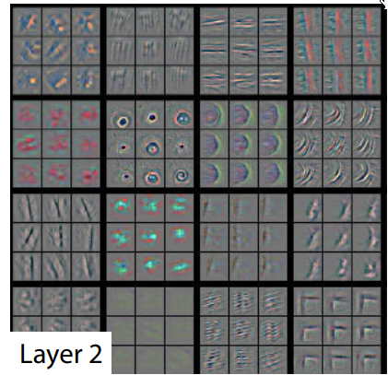
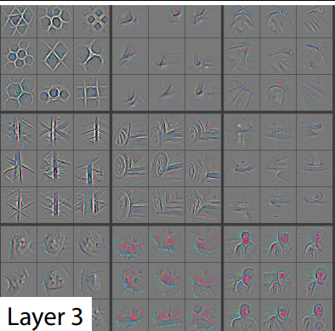

Slide 35
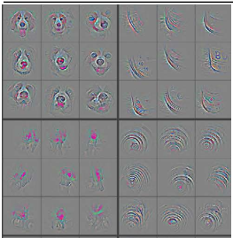
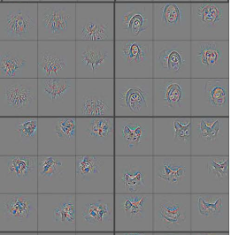

Slide 36
Lets get back…
Classification:
Now we can combine a convolution neural network with a classifier.
Classifier:
A neuron or group of neurons receive data and categorize them

Slide 37
But it is still at the beginnig ….

